Slide 1
Demand Prediction: EDA
12.08.2017
Nirmal Budhathoki
Garrett Cheung
Jillian Jarrett
Toby Moreno
Orysya Stus

Slide 2
Final Updates
Locally Based APIs
Documentation
Benchmarking API methods
Data Visualizations
Notes:
for organization and distrubution to other teams, we organized all apis as methods in single python file. Out of all apis we picked couple of them to run them from browser as well

Slide 3
Challenges
Data Integration
Knowing the data sources, understanding the business objectives and deliverables.
Data Locales
Data migrating from local computers to linode, and to UCSD servers
Querying Solr
Solr wrapper provided by query team
Working in parallel
Providing APIs for other teams as we create; team github; and weekly meetings
“If you are working on something for more than 5 hours, you are doing it wrong” -Prof. Gupta

Slide 4
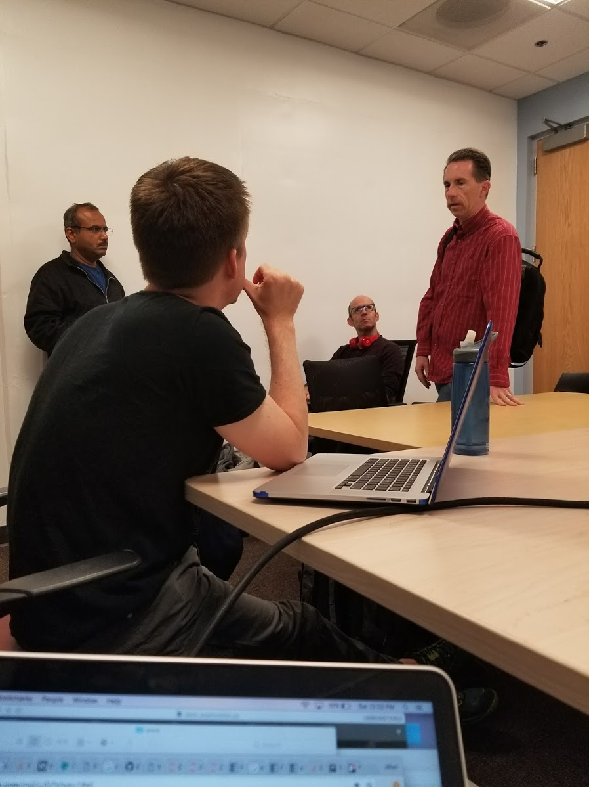
TEAMWORK

Slide 5
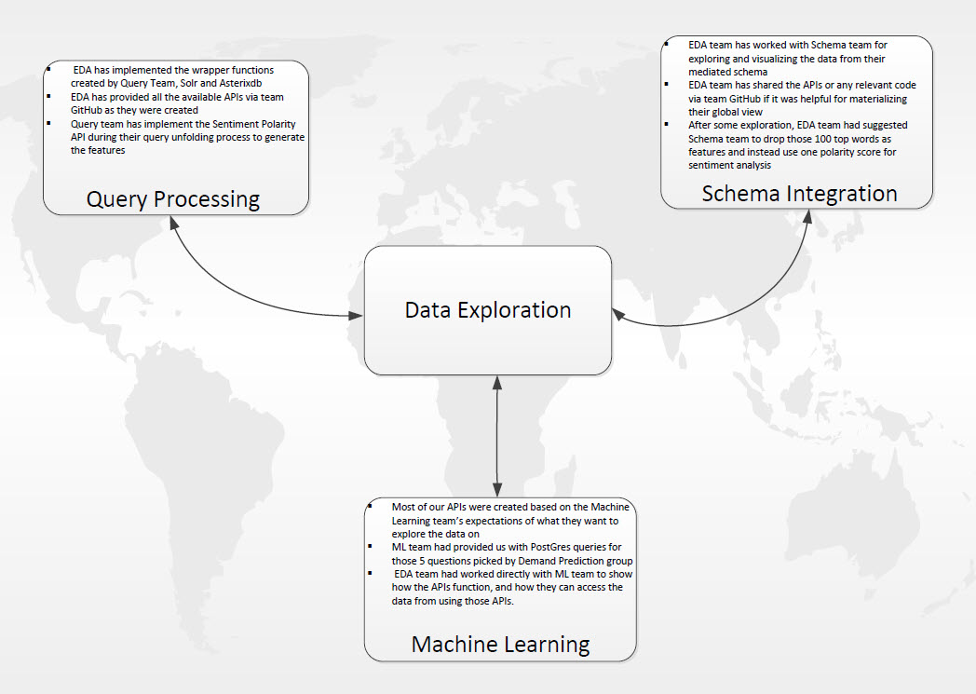
Collaborating With Other Teams
Notes:
nirmal

Slide 6
API Documentation
Used Sphinx to generate documentation for our API functions
Allows for easy navigation
Easily rewritable if docstrings or functions change
Available on our github or through our REST API local server:
http://localhost:5000/static/html/index.html

Slide 7
API DEMO
http://localhost:5000/static/html/index.html PYDOCS
http://localhost:8888 API Sample Code

Slide 8
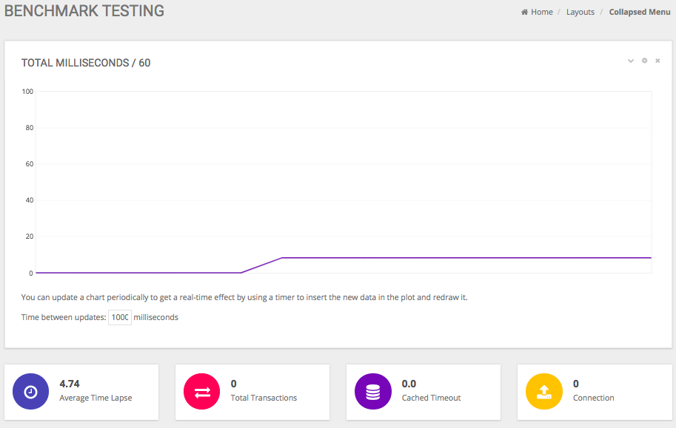
Benchmark and Optimization
http://localhost:5000/static/level1/benchmark_client.html

Slide 9
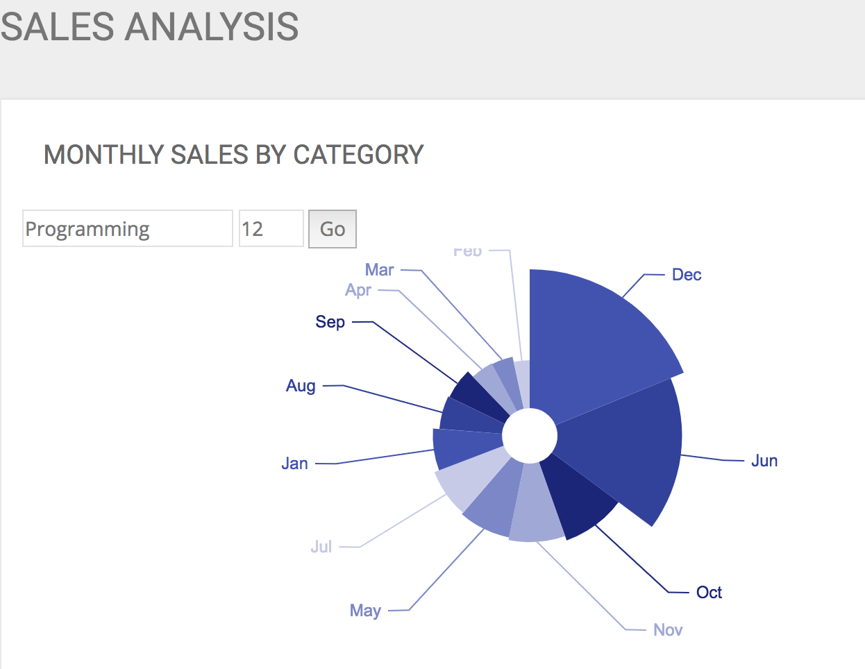
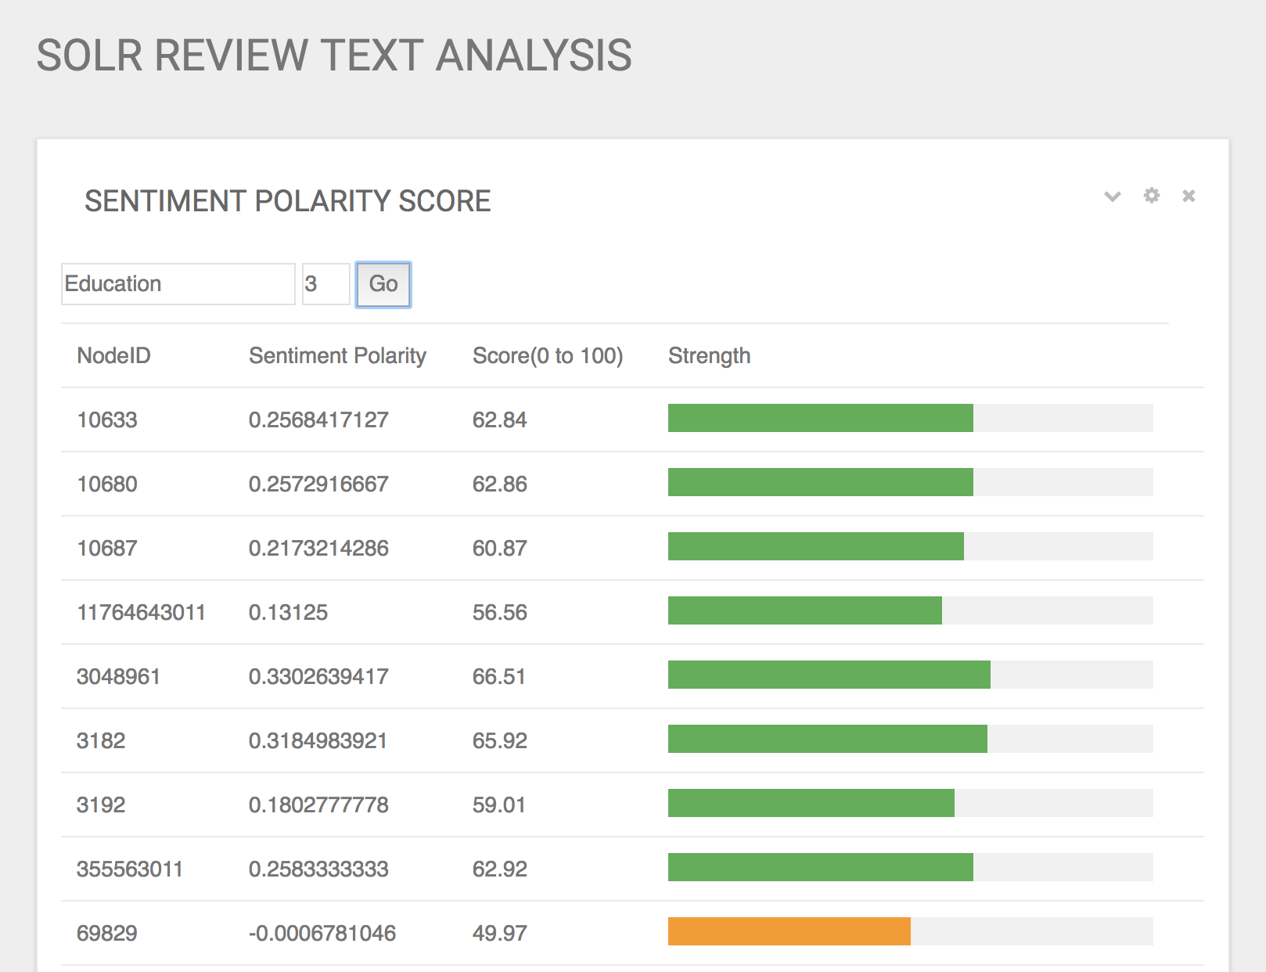
REST API Visualization
http://localhost:5000/static/level1/SalesByCategory.html http://localhost:5000/static/level1/SentimentPolarity.html

Slide 10
Tableau Data Visualizations
NodeId-related data views
Tables utilized from mediated schema:
reviews_agg_yrmn
sales_agg_yrmm
https://public.tableau.com/profile/orysya.stus#!/vizhome/EDA_DemandPrediction/Demand

Slide 11
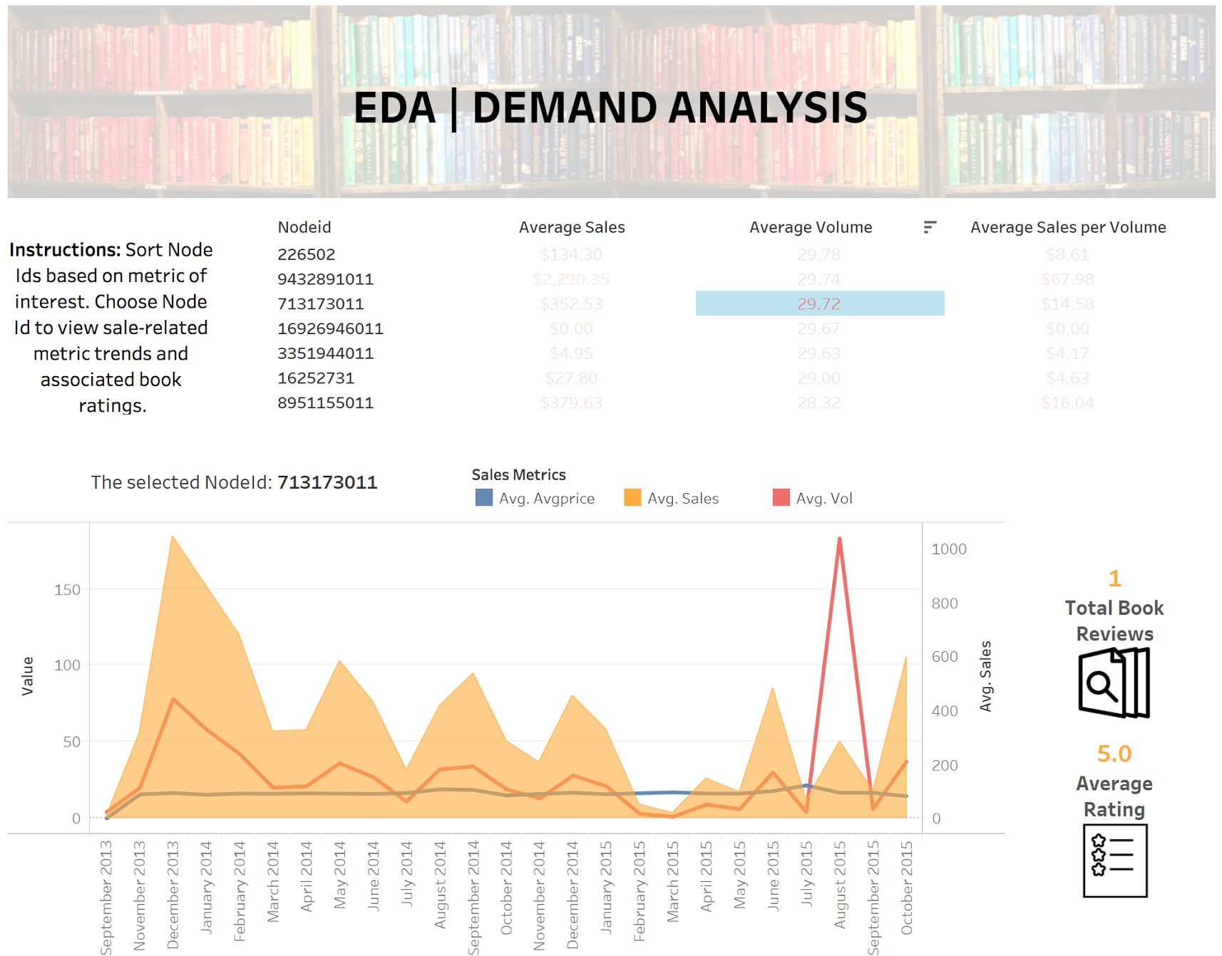
https://public.tableau.com/profile/orysya.stus#!/vizhome/EDA_DemandPrediction/Demand

Slide 12
THANK YOU

